Slide 1

Reported Anxiety Symptoms by Age
Dr. Kendra Mhoon
Team: Ashkon Mobli, Bobby Flores, Baraah Alshannaq, Sreekala Santhakumari
Notes:
Group Members: Ashkon Mobli, Baraah Alshannaq, Bobby Flores, Sree Santhakumari
We are looking at: Symptoms of Anxiety Disorder

Slide 2

The Data
The data used was collected as a part of the census bureau's household pulse survey. This data has been collected on a weekly basis over the last three years. The purpose of this survey was to produce data on the socioeconomic effects of coronavirus on American households.
For our data, the National Center for Health Statistics (NCHS), worked with the Census Bureau to develop this survey in order to obtain information regarding the frequency of anxiety symptoms.
Notes:
Pulling the data from: https://www.cdc.gov/nchs/covid19/pulse/mental-health.htm
CSV: https://data.cdc.gov/api/views/8pt5-q6wp/rows.csv?accessType=DOWNLOAD
The data is from April 23, 2020 to June 19, 2023.
The point estimate values provided were calculated using a 95% confidence interval.
The minimum sample sizes for age ranges were ranged from 100 to 7,473 based on the point estimates (value column) and the margins of error.
The margin of error range was from 0.95% to 7.1% based on the data provided.

Slide 3
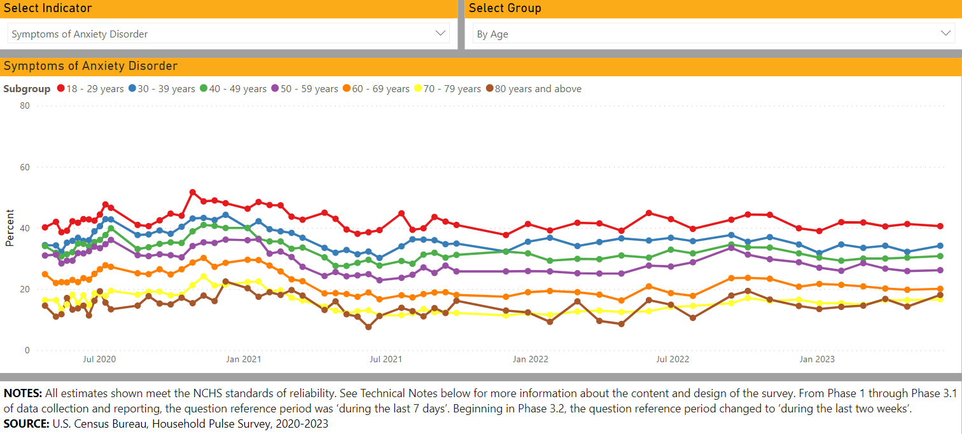
Reported Anxiety Symptoms Over Time
Through this visual we are able to see the relationship between age groups and reported anxiety symptoms over the course of three years. Visually it seems all groups were affected some way but through an F-test we will measure that significance.
Notes:
Visualization created with Microsoft Power BI
Citation:
National Center for Health Statistics. U.S. Census Bureau, Household Pulse Survey, 2020–2023. Anxiety and Depression.
Generated interactively: from https://www.cdc.gov/nchs/covid19/pulse/mental-health.htm. Accessed July 7, 2023.

Slide 4
Interpretation
We performed multiple F-tests to derive significance in the difference of means. What we found was that all subgroups besides "18 – 29 years", and "80 years and above" experienced a significant change in reports of anxiety over this period of time. This could be due to a variety of different factors.
What we can see is that Coronavirus significantly affected age groups 30 - 79 years of age based on these F-tests.
Subgroup | F Value | p value | F Critical Value
18 - 29 years | 2.007 | 0.124 | 2.776
30 - 39 years | 7.098 | 0.000 | 2.776
40 - 49 years | 9.748 | 0.000 | 2.776
50 - 59 years | 12.251 | 0.000 | 2.776
60 - 69 years | 10.974 | 0.000 | 2.776
70 - 79 years | 7.748 | 0.000 | 2.776
80 years and above | 0.647 | 0.588 | 2.776

Slide 5

Conclusion
The Household Pulse Survey in collaboration with five federal agencies has produced this data weekly for the last three years.
F tests were performed on each age group to determine a significant change over the three-year period.
Subgroups "18 – 29", and "80 and above" experienced no significant change while all other groups seemingly did.
It is possible younger adults are more adaptable, while older adults are generally less affected by change.
The presence of Coronavirus likely affected all groups, but through the presence of unknown variables, the significance may be lost.

Slide 6
References
National Center for Health Statistics. U.S. Census Bureau, Household Pulse Survey, 2020–2023. Anxiety and Depression. Generated interactively: from https://www.cdc.gov/nchs/covid19/pulse/mental-health.htm

